Slide 1


EPC System
OVERVIEW

Slide 2
Architecture

Slide 3


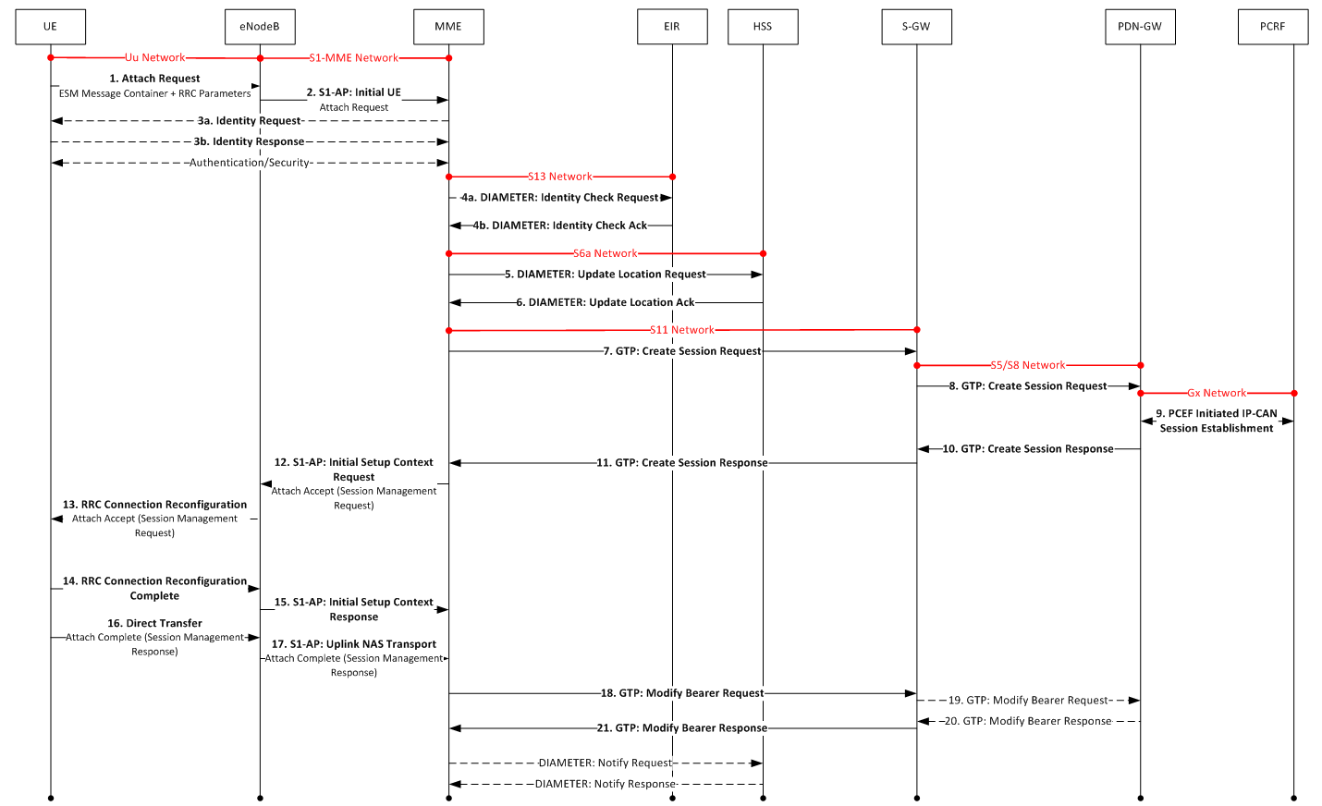
Call Flow

